Slide 1
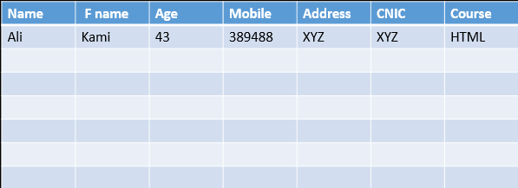
HTML Table
HTML Table:
A table in HTML consists of table cells inside rows and columns
To create table in HTML Web page we used <table> tag
To insert a row used <tr></tr> tag
To insert a column used <td></td> tag
Row and column transaction is the table cell
To insert a heading in the table used <th></th>
As table is the data structure in which data store in row and column form

Slide 2
HTML Table Size
HTML Table Width and Height
<table width="200px" height="400px">
…..
</table>
Column Width
<tr>
<th width="300px">JafriCode1</th>
<th>JafriCode2</th>
<th>JafriCode2</th>
</tr>
Row Height in Table
<tr height="400px">
<th>JafriCode1</th>
<th>JafriCode2</th>
<th>JafriCode3</th>
</tr>

Slide 3
HTML Table Colspan and rowspan
Colspan
Used to merge one or more than two column into one
Rowspan
Used to merge one or more than two row into one

Slide 4
Table Caption
To provide a title to a table, we used a table caption
<table>
<caption>Student Records..</caption>
</ table>

Slide 5
Table Header, Body, and Footer
Manage different section of a table using:
Table Header
Table Body
Table Footer
<thead> Used to set header for a table
<tbody> Used to set body for a table
<tfoot> Used to set footer for a table

Slide 6
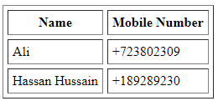
Cellpadding and Cellspacing
Cellpadding and Cellspacing
The cellspacing attribute show space between content of the cell and border of the cell.
The cellspacing attribute show space between cells.
Example
<table border = "1" cellpadding = "5" cellspacing = "5">
<tr>
<th>Name</th>
<th>Salary</th>
</tr>
<tr>
<td>Raman</td>
<td>10000</td>
</tr>
<tr>
<td>Shabbir Hussain</td>
<td>2000</td>
</tr>
</table>

Slide 7

HTML Table Heading
Table Heading
<th></th> tag is used to create heading in Table
Example:
<table border = "1">
<tr>
<th>Name</th>
<th>Salary</th>
</tr>
<tr>
<td>Faisal</td>
<td>8999</td>
</tr>

